Slide 1
MRA Project Milestone 2
Presented By: Tejas Padekar
Batch: PGP DSBA – G1
Email: tnpadekar@gmail.com

Slide 2
AGENDA:
About data
EDA
Inferences
Market Basket Analysis
Recommendations

Slide 3
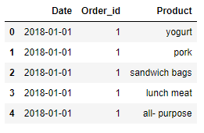
PROBLEM STATEMENT:
A Grocery Store shared the transactional data with you. Your job is to identify the most popular combos that can be suggested to the Grocery Store chain after a thorough analysis of the most commonly occurring sets of menu items in the customer orders. The Store doesn’t have any combo meals. Can you suggest the best combo meals?
Below is head of the dataset

Slide 4
ABOUT DATA
There are 20641 rows and 3 columns.
There are 1 Integer and 2 object data types.
There are no null values in the dataset.
There are 4730 duplicate rows in the dataset.
Data is available for 3 years 2018, 2019 and 2020
Data for each year 2018 and 2019 is provided until Q3 ie; September only and for 2020 it is provided for January and February only
A total of 1139 orders were received during this timeline.
There are 37 unique Products as of today with the store.

Slide 5
EXPLORATARY DATA ANALYSIS
We have used Python and Tableau for performing EDA

Slide 6
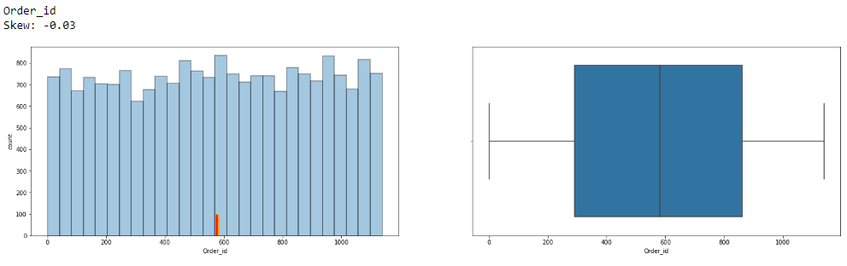
UNIVARIATE ANALYSIS DATA DISTRIBUTION & OUTLIERS
There are no outliers, no high skewness in Order_id and the data seems to be normally distributed as well.

Slide 7
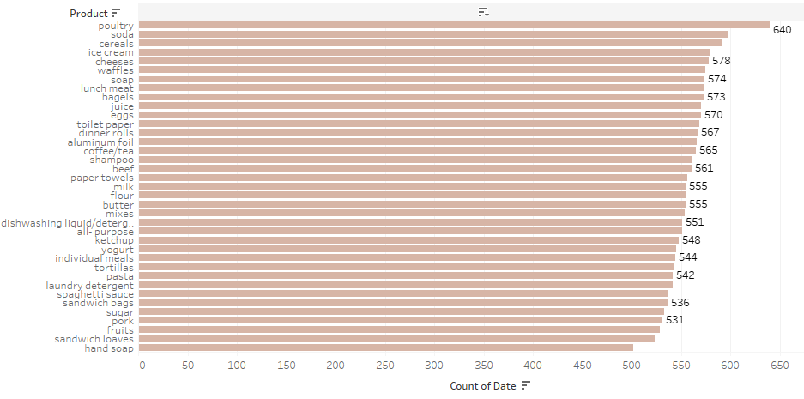
PRODUCT QUANTITY ORDERED MOST
Poultry accounts for highest purchased product quantity followed by Soda in 2nd and Cereal in the 3rd position.
Hand Soup is the least purchased product quantity followed by Sandwich loaves and Fruits.
There is not a drastic difference between the range in which all the products quantity are ordered.

Slide 8
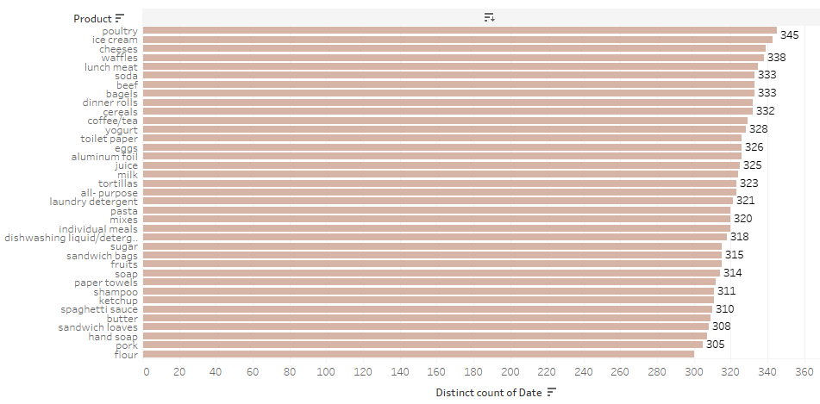
PRODUCT ORDERED MOST
Poultry accounts for highest purchased product followed by Ice Cream in 2nd and Cheeses in the 3rd position.
Flour is the least purchased product followed by Pork and Hand Soaps.
There is not a drastic difference between the range in which all the products are purchased.

Slide 9
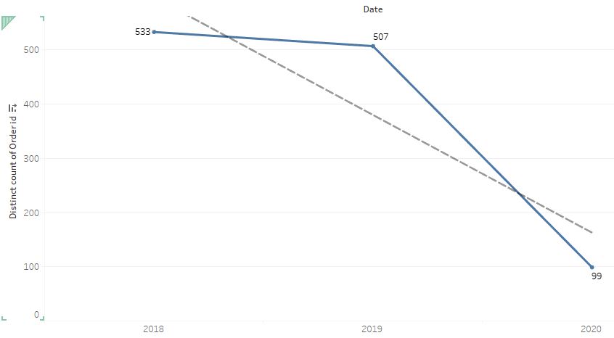
YEARLY ORDERS AND TREND
The store does not see high number of orders annually.
Number of orders are also seen reducing year on year.

Slide 10
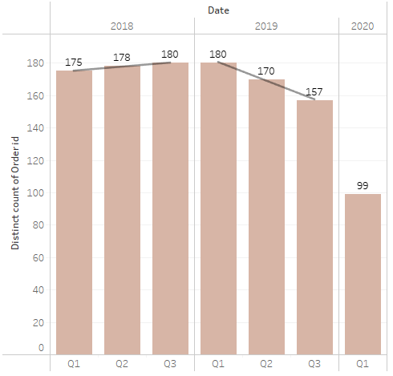
QUARTERLY ORDERS AND TREND
In 2018, Q1 to Q3 order count has slightly increased with Q3 receiving the highest order for 180.
In contrast to 2018, Q1 to Q3 order count has decreased significantly with Q3 receiving the lowest orders for 157.
Data shows inconsistency of customer visits to the store.
No data available for Q4 for both 2018 and 2019.

Slide 11
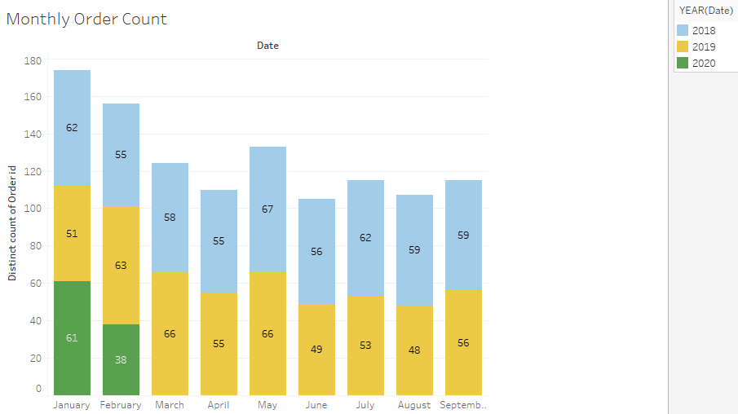
MONTHLY ORDERS
January has received highest orders due to the inclusion of 2020 data as well.
May 2018 received the highest order of 67 and following year it received 66 orders.
June followed by August and April received the lowest orders.

Slide 12
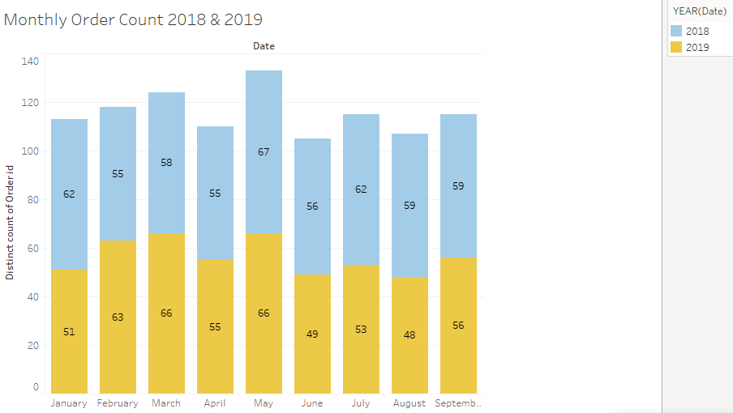
MONTHLY ORDERS EXCLUDING 2020
May month brings good orders followed by March and February.
August 2019 had received the lowest order of 48.
There is significant drop in orders between May - June and March – April.

Slide 13
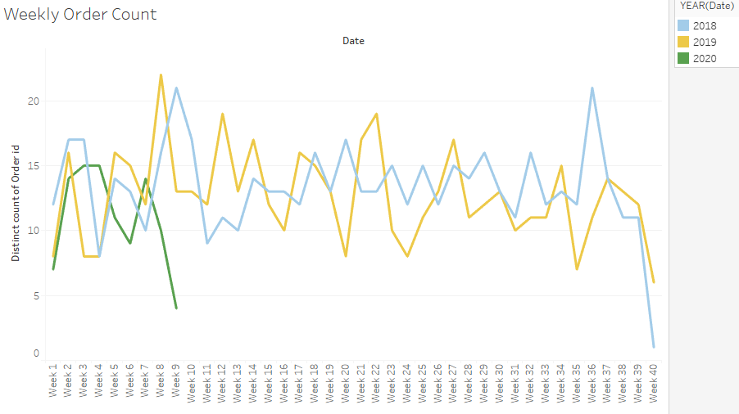
WEEK-WISE ORDERS TREND
In contrast to 2018 and 2019, week 5, 8 and 9 has seen a fall in orders for 2020 whereas, week 7 was the opposite. Week 20, 23 saw a rise in orders in 2018 whereas it saw a significant drop in 2019. Week 40 shows a big dip in the orders.
The above patterns indicate lack of consistency in order placing.

Slide 14
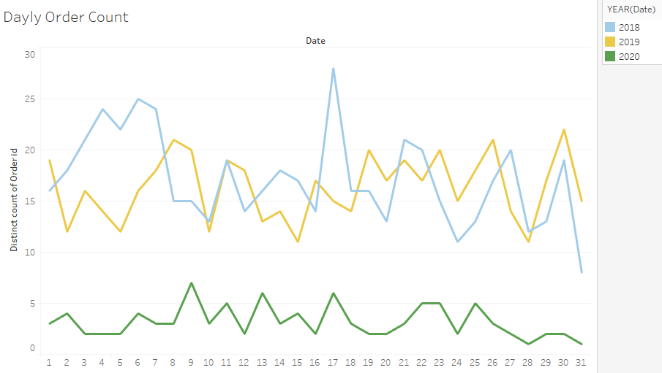
DAY-WISE ORDERS TREND

Slide 15
INFERENCES:
There are 20641 rows and 3 columns.
Data is available for 3 years 2018, 2019 and 2020.
Data for each year 2018 and 2019 is provided until Q3 ie; September only and for 2020 it is provided for January and February only.
A total of 1139 orders were received during this timeline.
There are 37 unique Products with the store.
Poultry accounts for highest purchased product quantity followed by Soda in 2nd and Cereal in the 3rd position.
Hand Soup is the least purchased product quantity followed by Sandwich loaves and Fruits.
There is not a drastic difference between the range in which all the products quantity are ordered.
Poultry accounts for highest purchased product followed by Ice Cream in 2nd and Cheeses in the 3rd position.
Flour is the least purchased product followed by Pork and Hand Soaps.
There is not a drastic difference between the range in which all the products are purchased.

Slide 16
INFERENCES:
The store does not see high number of orders annually.
Number of orders are also seen reducing year on year.
In 2018, Q1 to Q3 order count has slightly increased. However, in 2019, Q1 to Q3 order count has decreased significantly.
Q3 was best in terms of orders received for 2018 but it received the lowest orders in the same quarter for 2019.
Data shows inconsistency of customer visits to the store.
January has received highest orders due to the inclusion of 2020 data as well
May 2018 received the highest order of 67 and following year it received 66 orders.
June followed by August and April received the lowest orders .
May month brings good orders followed by March and February.
August 2019 had received the lowest order of 48.

Slide 17
INFERENCES:
There is significant drop in orders between May - June and March – April.
In contrast to 2018 and 2019, week 5, 8 and 9 has seen a fall in orders for 2020 whereas, week 7 was the opposite.
Week 20, 23 saw a rise in orders in 2018 whereas it saw a significant drop in 2019 during these weeks. Week 40 shows a big dip in the orders.
Week 17, 26, 30, 37 saw orders increasing in 2019 whereas in 2018 orders had decreased during these weeks.
Weekly Order Trend shows inconsistency in order placing or demand by the consumer.
There is presence of seasonality in the dataset.
Day-Wise we can see that 17th and 30th see highest orders.
Orders range typically between 10 to 20 orders per day.

Slide 18
MARKET BASKET ANALYSIS

Slide 19
MARKET BASKET ANALYSIS AND ADVANTAGES
Market Basket Analysis (MBA) is a data mining technique used by retailers and businesses to understand consumer buying patterns/behaviors to design strategies for increasing revenue and profits.
Its main purpose is to identify the products which are purchased frequently in combination with other items and how strongly these combination of purchases can help increase the revenues. For eg; If consumer buys products A & B then he/she would buy C as well.
Advantages of MBA:
A. Increases sales, cross-selling, consumer loyalty and CLV
B. Helps in designing relevant promotional campaigns
C. Create online recommendation engines
D. Design inventory procurement priorities
E. Helps with in-store product placement

Slide 20
THRESHOLDS
SUPPORT: This helps in identifying the frequency of occurrence for a set of products in an order or which set of products are purchased together the most out of the total purchases made. Set of products with higher support are likely to be purchased more frequently than the one’s with a lower support.
For our project we have set minimum support as 0.05
CONFIDENCE: This denotes the probability of purchases containing recommended products (Consequent) in the same purchases already containing the set of products (Antecendent). For eg; How many purchases which contain product A (set of products) also contain product B (consequent). A higher confidence means its most likely that B will also be purchased if A is present in the order.
For our project we have set minimum confidence as 0.05
LIFT: This suggests the probability of purchasing recommended products if set of products are already present in order and if there is any association between the two. If lift is > 1, then the probability of purchasing recommended products increases if set of products are present in the order and it can be said that there is an association between the two and vice versa. A higher lift indicates higher level of association.

Slide 21
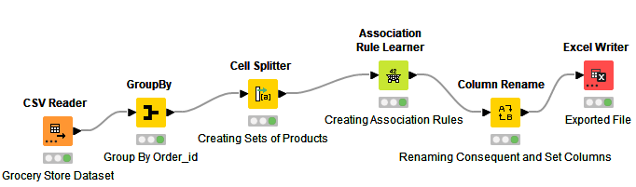
KNIME MBA WORKFLOW
Data is Grouped by Order_id
Products are concatenated
Set of Products are created using Cell Splitter
Support is set at minimum 0.05
Confidence is set at minimum 0.5
We got a total of 1247 rules
Consequent and Set Columns are renamed to Recommended_Product and Set_of_Products respectively

Slide 22
ASSOCIATION RULES
Association Rule determines the frequency of occurrence of an itemset in a purchase order where itemset represents a set of products.
It helps show how strong or weak the associations between the products are. It determines that products having strong associations are often purchased together in most cases and products with weak associations are said to be independent of each another.
Using the association rules we would be able to determine which products have strong associations and which are often purchased together helping our store owner to form cross-selling strategies, promotional or/and combo or/and discount offers, shuffle with in-store product placement etc.
Moreover, the association rules are proven to be very useful for retailers which again makes it very relevant for our grocery store to make use of the same and increase revenue and profits.

Slide 23
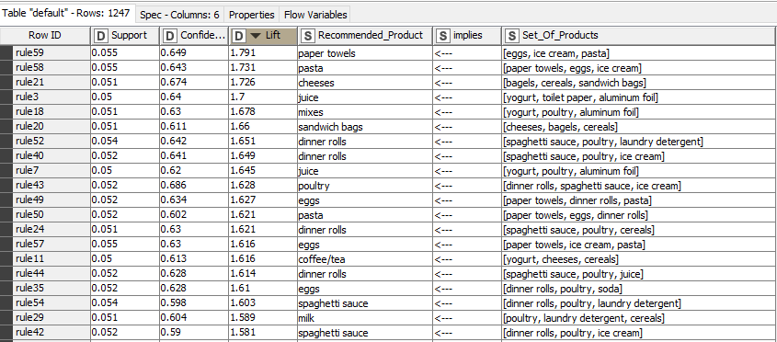
ASSOCIATION RULE OUTPUT
Top 20 rows of Association Rule Output sorted by Lift in descending order.

Slide 24
INTERPRETATION OF ASSOCIATION RULES OUTPUT
In Rule 59, there is support that 5.5% orders have eggs, ice cream, pasta and paper towels. If eggs, ice cream and pasta are purchased in an order, then there is confidence of 64% that paper towels will also be purchased in the same order or and there is 79% chance that wherever eggs, ice cream and pasta are in an order, paper towels will also be purchased.
In Rule 58, there is support that 5.5% orders have eggs, ice cream, pasta and paper towels. If eggs, ice cream and paper towels are purchased in an order, then there is confidence of 64% that pasta will also be purchased in the same order and there is 73% chance that wherever eggs, ice cream and paper towels are in an order, pasta will also be purchased.
In Rule 21, there is support that 5.5% orders have bagels, cereals, sandwich bags and cheeses. If bagels, cereals, sandwich bags are purchased in an order, then there is confidence of 67 % that cheeses will also be purchased in the same order and there is 73% chance that wherever bagels, cereals, sandwich bags are in an order, cheeses will also be purchased.

Slide 25
RECOMMENDATIONS – KNIME ANALYSIS
Can roll out Combo offers for eggs, ice cream, pasta and paper towels or can offer 5% discount on Pasta if paper towels, eggs and ice cream are already purchased as pasta has a lower rate of order.
Can roll out Combo offers for bagels, cereals, sandwich bags and cheeses or can offer 15% discount on sandwich bags if bagels, cereals and cheeses are already purchased as sandwich bags have a lower rate of order.

Slide 26
RECOMMENDATIONS – KNIME ANALYSIS
Can roll out Combo offers for yogurt, poultry, aluminium foil and mixes
Can roll out Combo offers for dinner rolls, spaghetti sauce, poultry and ice cream/cereals/laundry detergent or can also provide free dinner rolls if spaghetti sauce, poultry and ice cream/cereals/laundry detergent are purchased. This can help improve the sale of spaghetti sauce as the other items are purchased regularly and spaghetti sauce would cover the cost of dinner rolls.

Slide 27
RECOMMENDATIONS – KNIME ANALYSIS
Can roll out Breakfast Combo for coffee/tea, yogurt, cheeses and cereals during the weeks and months with lower sales. Also these products can be placed close to each other to increase the chance of being purchased together. Can offer 10% discount on Yogurt if cheeses, cereals and coffee/tea is purchased.
Can roll out Lunch Meal Combo offers for individual meals, sandwich loaves and lunch meat.

Slide 28
RECOMMENDATIONS – KNIME ANALYSIS
Can roll out Combo offers for eggs, paper towels, dinner rolls and pasta as seen in rule49 or eggs, dinner rolls, towels, poultry and soda as seen in rule35. Can also offer 10% discount on eggs if purchased with either of the two rules.
Can offer 10% discount on laundry detergent if poultry, milk and cereals are already purchased. This way, we can try and improve sales of laundry detergent using the combo of the other products. We can also offer all four products at a reasonable price.

Slide 29
RECOMMENDATIONS – KNIME ANALYSIS
Can roll out Combo offers for sandwich loaves, cheeses and ketchup while also placing them near each other.
Can roll out Combo offers for soda, eggs, dinner rolls and poultry.

Slide 30
THANK YOU

